Slide 2
God Came Near
Exodus 25:1-9

Slide 3
The Story So Far…
Creation (Gen. 1-2)
Adam/Fall (Gen. 3-5)
Noah/Flood (Gen. 6-10)
Abraham (Gen. 11-25)
Isaac (Gen. 26-27)
Jacob/Joseph/Egypt (Gen. 28-50)
Slavery/Moses/Exodus (Ex. 1-12)
Desert/Laws/Covenant (Ex. 13-24)

Slide 4
¹ The Lord said to Moses, ² “Tell the Israelites to bring me an offering. You are to receive the offering for me from everyone whose heart prompts them to give.”
Exodus 25:1-2 NIV

Slide 5
⁸ Then have them make a sanctuary for me, and I will dwell among them.
⁹ Make this tabernacle and all its furnishings exactly like the pattern I will show you.”
Exodus 25:8-9

Slide 6
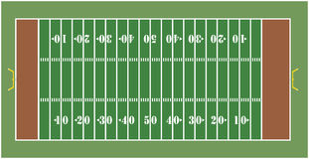
Courtyard
Tabernacle

Slide 7
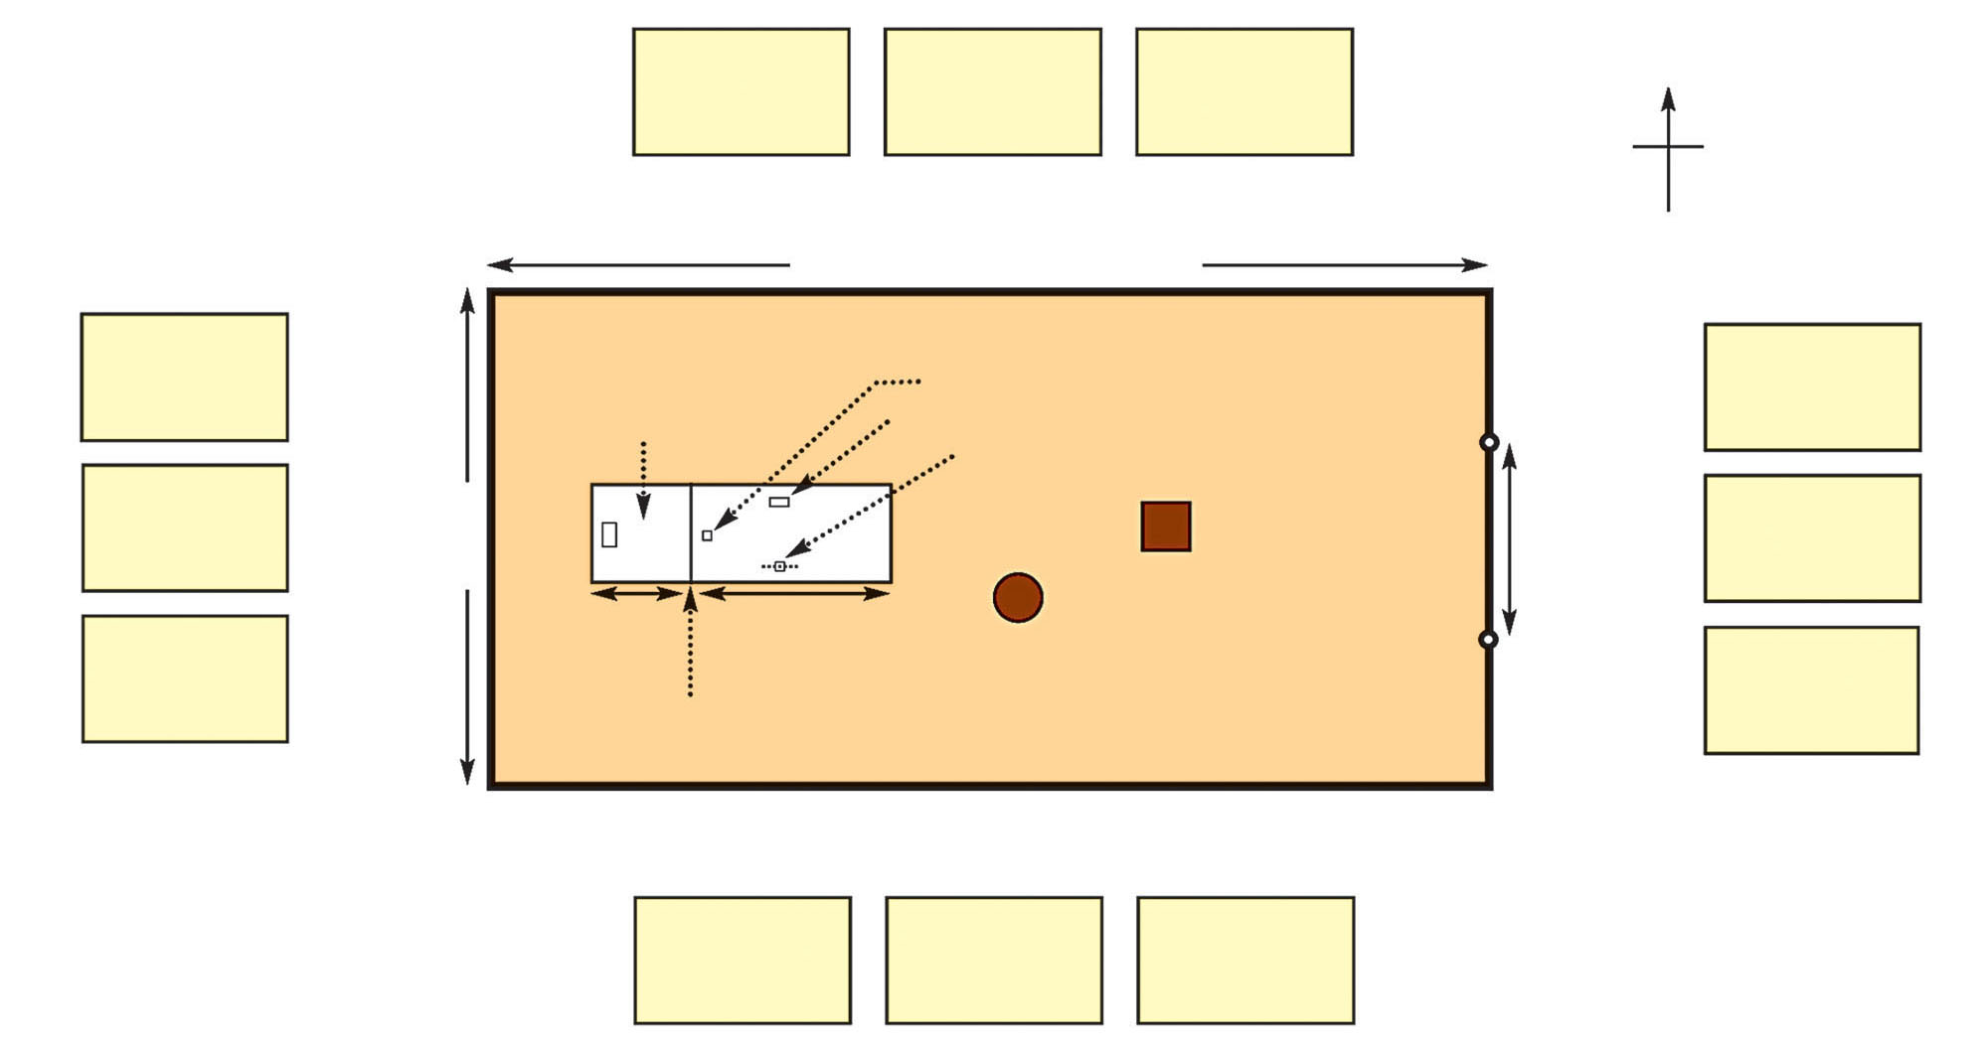
Tribes Around the Tabernacle
Tribe of Naphtali
53,400
Tribe of Asher
41,500
Tribe of Dan
62,700
N
W
E
The families of Merai (Num. 3)
100 cubits (150 ft. or 46 m)
S
Tribe of Ephraim
40,500
Most Holy Place with Ark of the Covenant
Holy Place with
Tribe of Issachar
54,400
Altar of Incense
Table of Bread
Lampstand
Tribe of Manasseh
32,200
Tribe of Judah
74,600
The families of Gershonites (Num. 3)
50 cubits (75 ft. or 23 m)
Moses, Aaron, and Sons (Num. 3)
Entrance (20 cubits)
Bronze Altar
10 cubits
20 cubits
Tribe of Benjamin
35,400
Bronze Laver
Tribe of Zebulun
57,400
Veil
The families of Kohath (Num. 3)
1 cubit = 1 ½ feet or 46 centimeters
Tribe of Gad
45,650
Tribe of Simeon
59,300
Tribe of Reuben
46,500

Slide 8
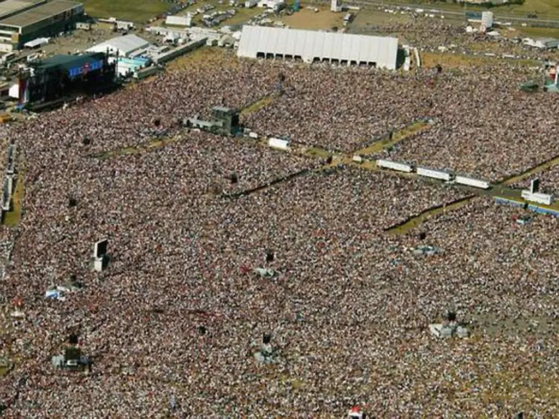
500,000 People at a Concert

Slide 9
500,000 People at a Concert
The Tabernacle was surrounded by roughly 2,000,000 people plus their tents and livestock!

Slide 10
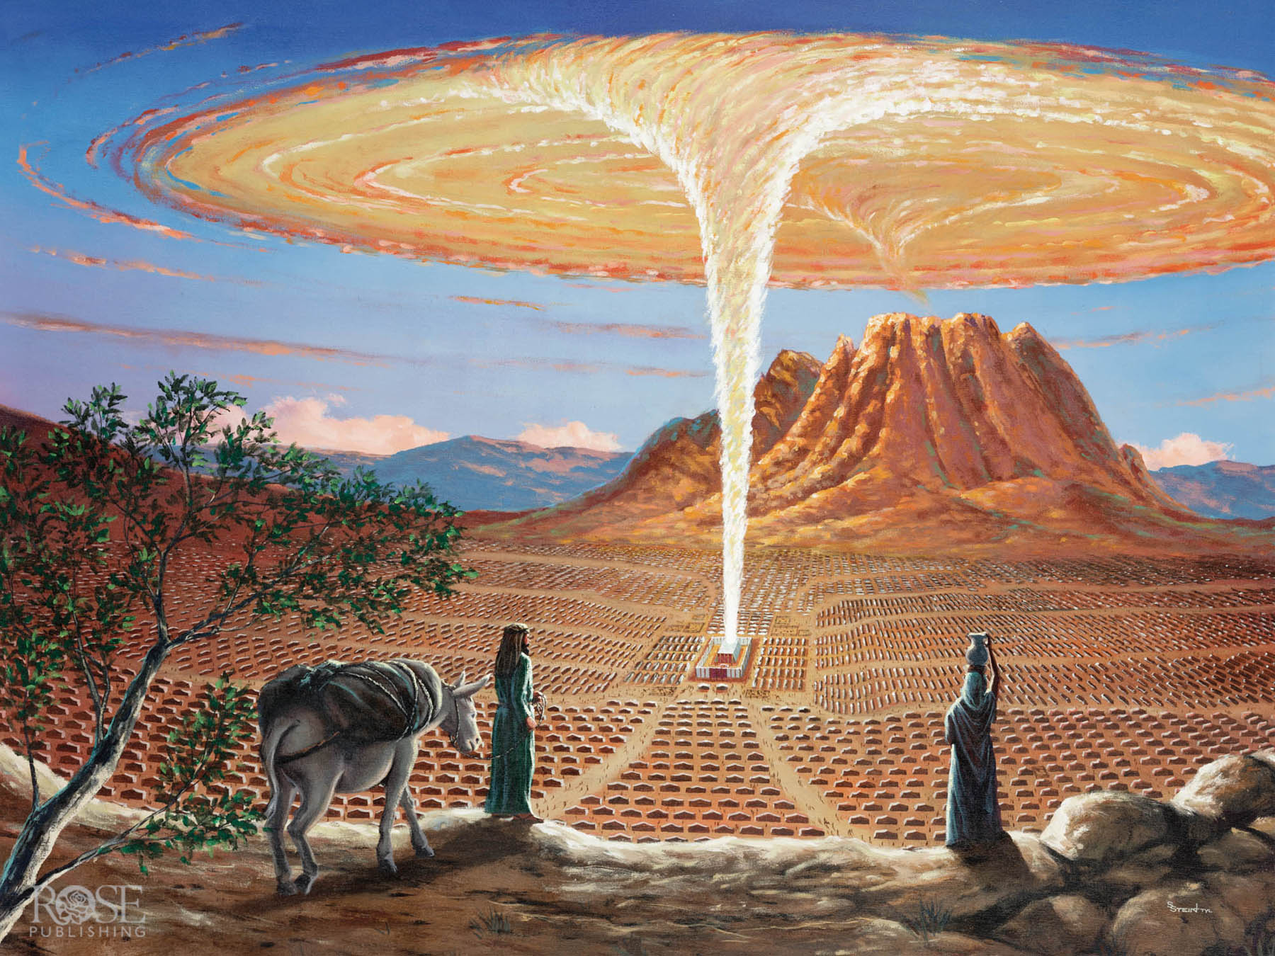
Notes:
Art by Stan Stein

Slide 11
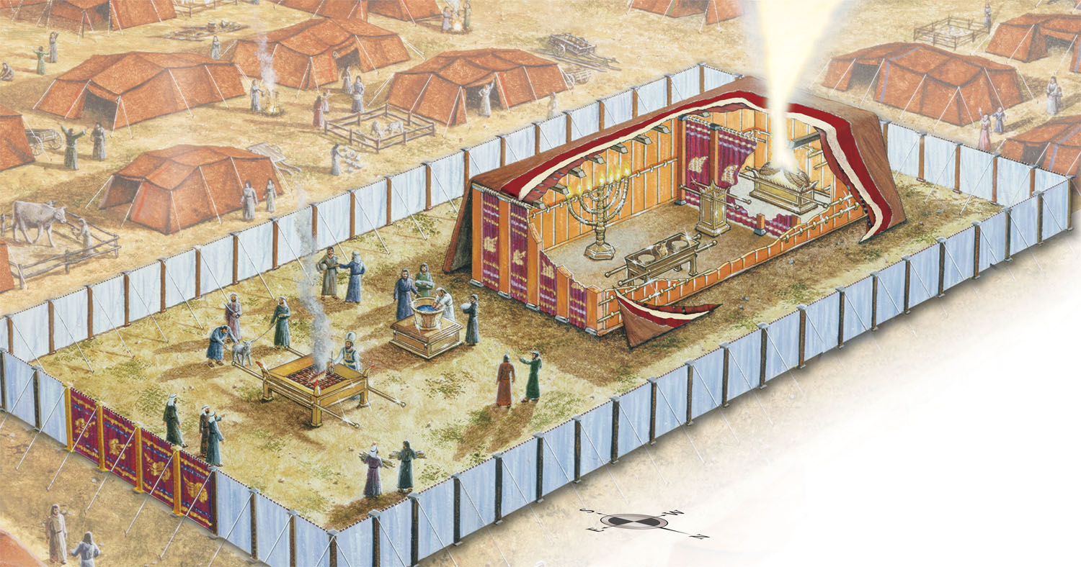
The Tabernacle
Ark
Veil
Lampstand
Laver
Altar
Altar Of
Incense
Gate
Table of Bread
Fence
Notes:
Art by Stan Stein

Slide 12
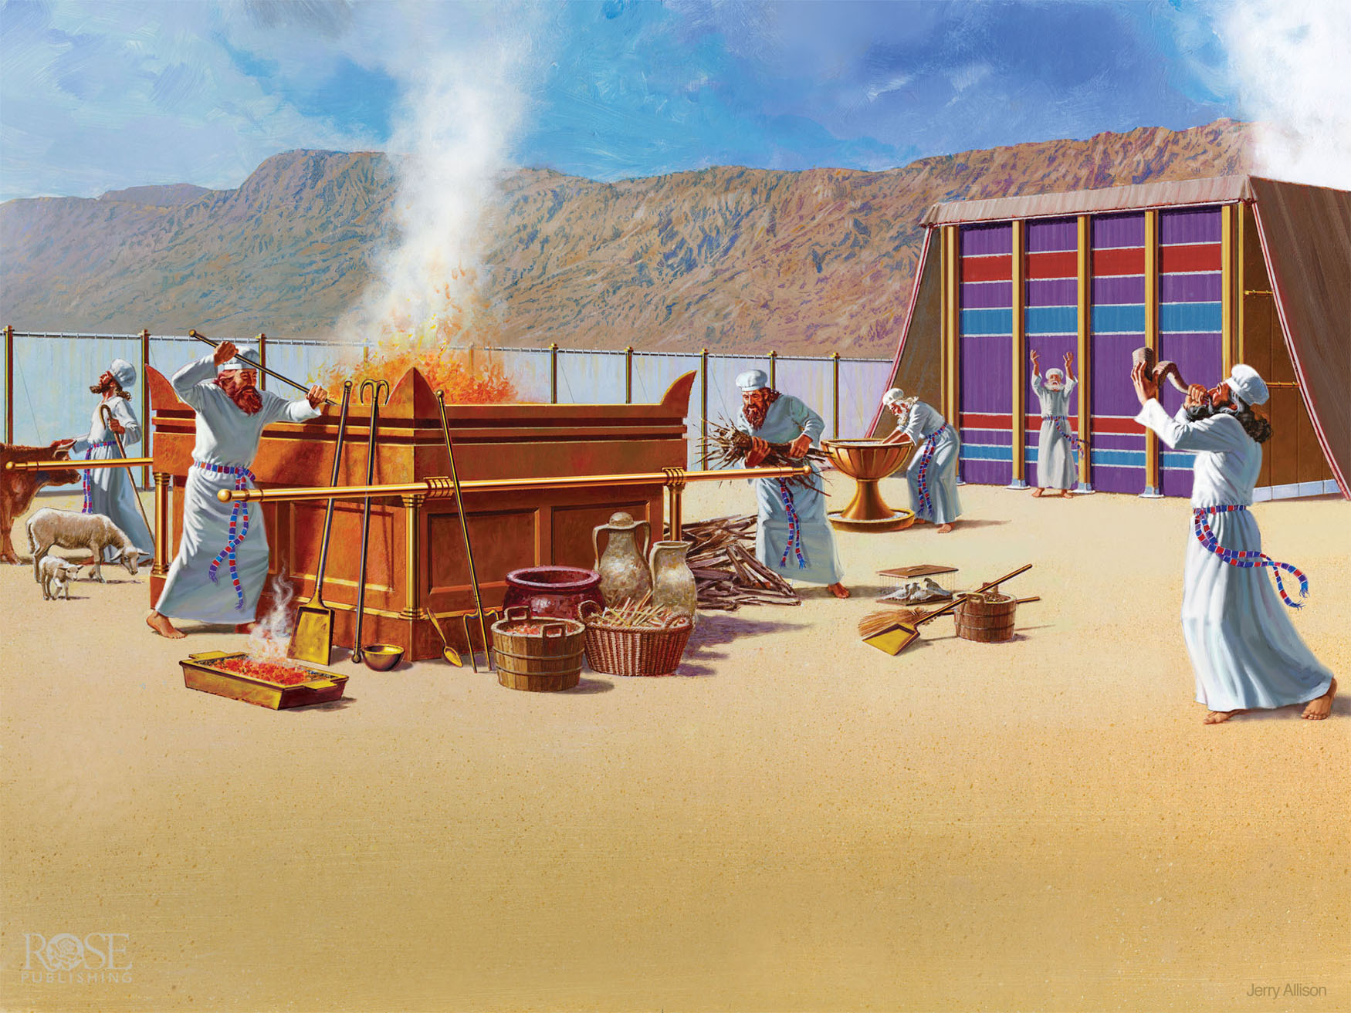
The Tabernacle
Bronze Altar
Bronze Laver
The Courtyard
Notes:
Art by Jerry Allison

Slide 13
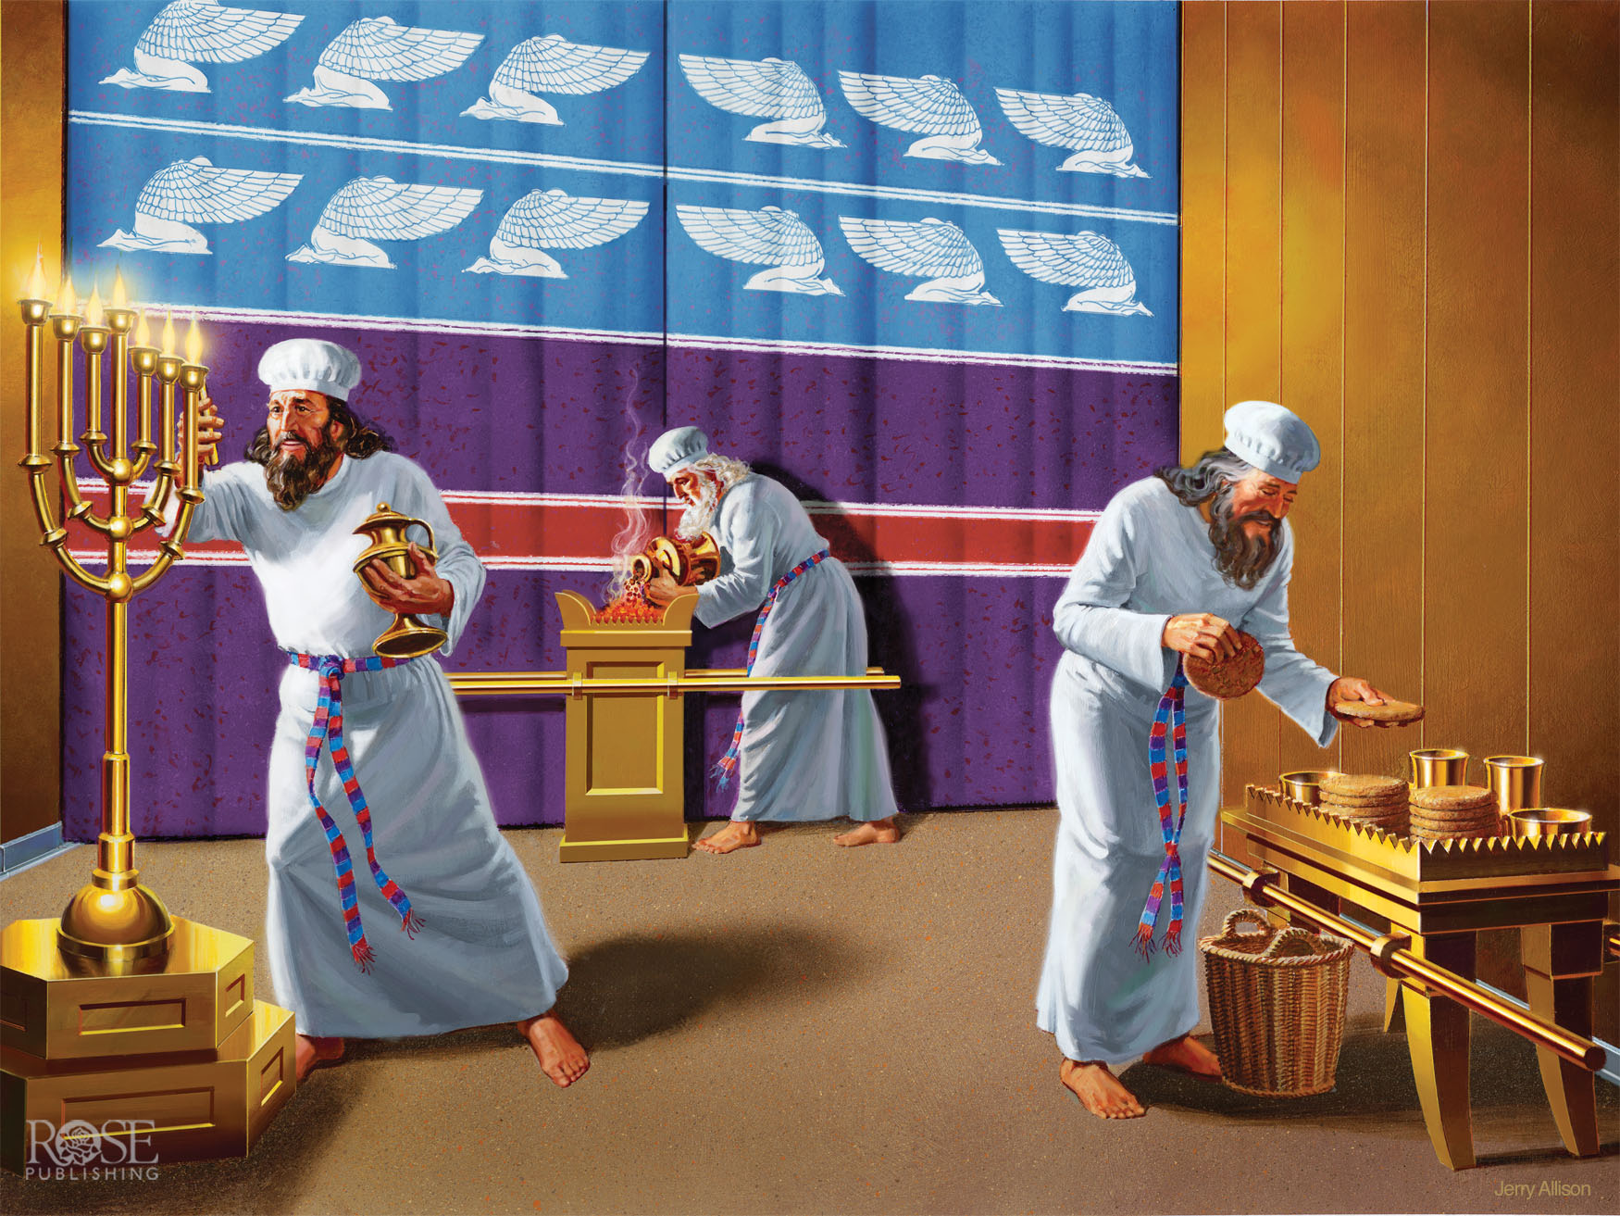
Lampstand
Veil
Altar of Incense
Table of Bread
The Holy Place
Notes:
Art by Jerry Allison

Slide 14
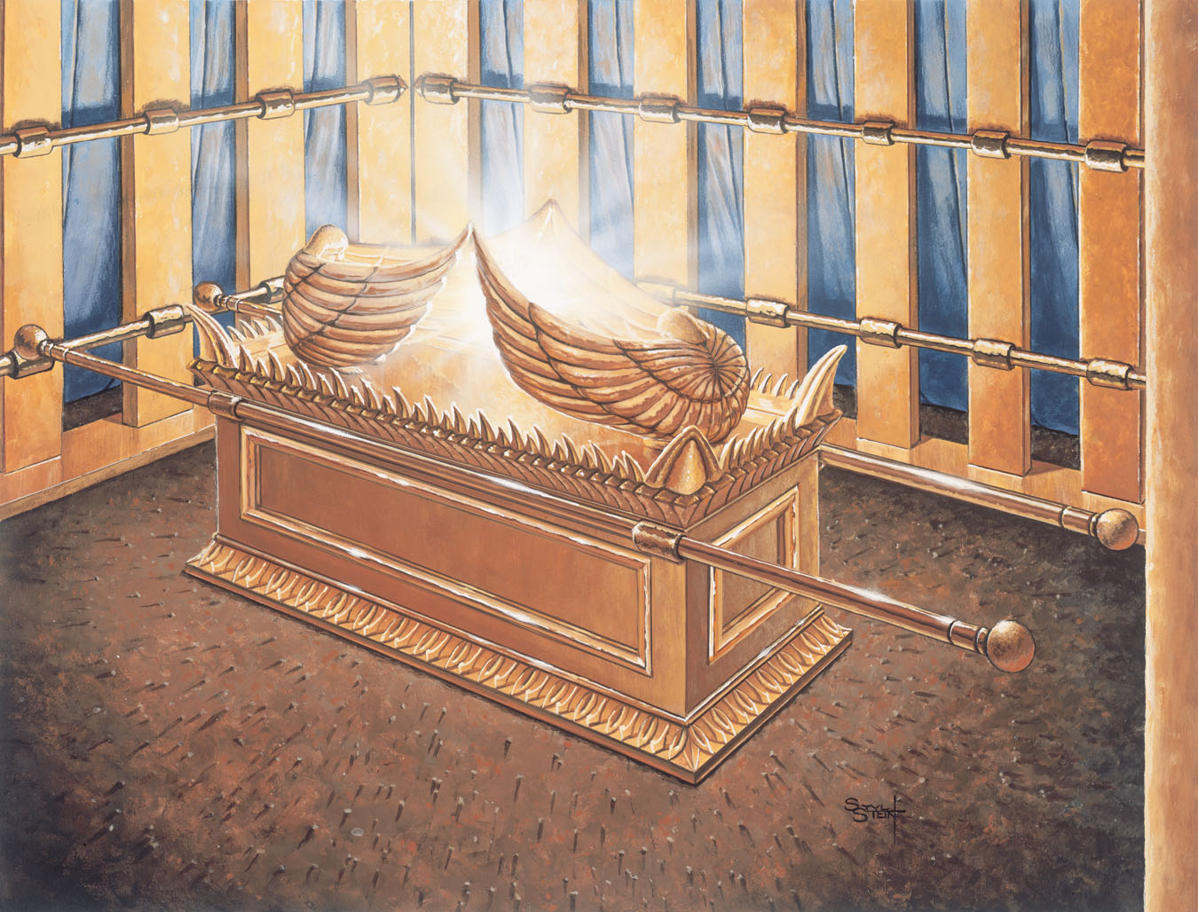
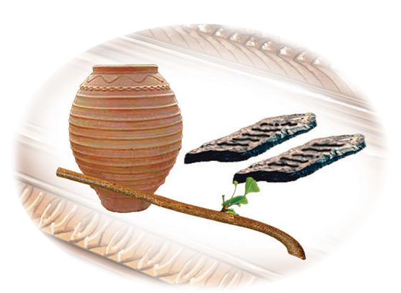
The Most Holy Place
Mercy Seat
Jar of Manna
Ark
Aaron’s Rod
Stone Tablets
The Most Holy Place
Notes:
Art by Stan Stein

Slide 15
God’s Pattern for Worship
Be reconciled to God through blood sacrifice.
Be washed through confession & repentance of our sins.
Be enlightened by the Holy Spirit living in us.
Be fed by God’s Word to know & live the truth.
Be prayerful in dependence on God’s work on our behalf.

Slide 16
God Came Near
 | Us Near to God | God Near to Us
Old Testament | Blood of Animals | Tabernacle/Temple
Gospels | Blood of Jesus | Jesus (God with us)
Acts to Jesus’ return | Blood of Jesus | Holy Spirit (God in us)
God Came Near
God Came Ne

Slide 17
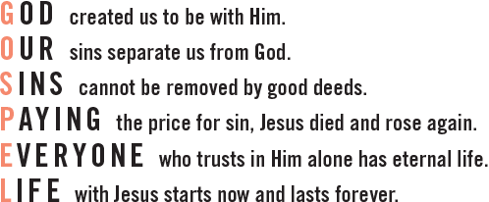
LifeIn6Words.com

Slide 18
God Came Near
Exodus 25:1-9

